Slide 1


Asthma vs. Influenza: Data Analysis
Gender, Age, Race, Geography, Medical Appointments, and Statistical Insights
TEAM 1
ARJUN PALANISWAMY, EUID: ap1839
AAVULA USHA, EUID: ua0095
KAUSHIKAN DINAKARAN, EUID: kd0596
ROHITH SINGH THAKUR, EIUD: rt0674

Slide 2

INTRODUCTION
Study Focus: Analyzing two major conditions: Asthma (ICD-10: J45) and Influenza (ICD-10: J11).
Importance:
Asthma is a chronic condition where the airways become inflamed and hyperreactive, often triggered by allergens, irritants, or infections.
Influenza is a contagious respiratory virus that can cause widespread inflammation in the airways and lungs.
People with asthma are at a higher risk of severe complications from influenza, including exacerbations of asthma and secondary bacterial infections. Comparing these conditions helps identify vulnerable populations and design targeted preventive measures.
Objective: Use MEPS data to compare and analyze influenza and asthma in order to identify important trends and their implications for healthcare systems.

Slide 3
DATASET OVERVIEW
Data Source: Condition-level file (h214.csv & h216.csv) from the Medical Expenditure Panel Survey (MEPS).
Categorical columns: Variables like SEX, RACEV2X (Race), REGION42 (Geography), and ADAPPT42 (Appointments). Includes indicators such as ASPREV31 (preventive measures) and ASATAK31 (attack severity).
Numerical Columns: Age at diagnosis (AGEDIAG), expenditures (TOTEXP19), and adherence measures (ADHECR42).
Method of Filtering: ICD-10 codes (J11 for influenza, J45 for asthma) were used to filter the data. Deduplication made sure there was enough data for both scenarios.
Data preparation: Extracting numerical and categorical information to provide in-depth understanding. The importance for the analysis of influenza and asthma was ensured by filtering by ICD-10.

Slide 4

Research Questions
1. Is there a gender difference in asthma and influenza diagnoses?
2. How does the average age at diagnosis differ between asthma and influenza?
3. What are the racial/ethnic patterns in asthma and influenza prevalence?
4. Are there regional differences in asthma and influenza cases?
5. Is there a significant difference in medical expenditures between asthma and influenza groups?

Slide 5
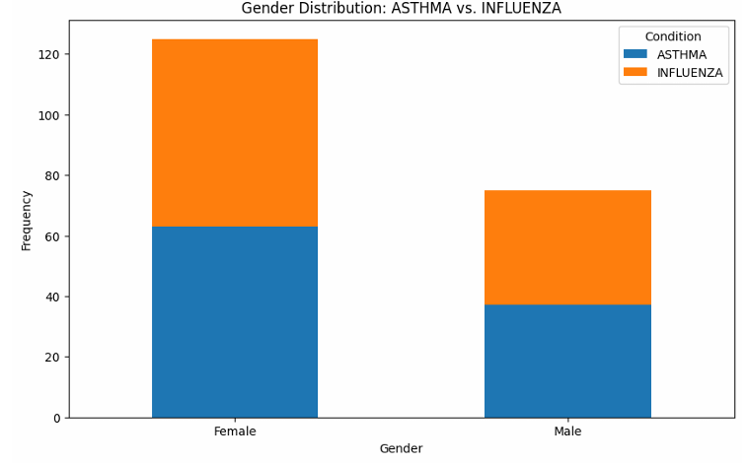
Gender Distribution: Asthma vs. Influenza
Asthma:
- Male: 37% (37 out of 100)
- Female: 63% (63 out of 100)
https://pmc.ncbi.nlm.nih.gov/articles/PMC5629917/
Influenza:
- Male: 38% (38 out of 100)
- Female: 62% (62 out of 100)
https://pmc.ncbi.nlm.nih.gov/articles/PMC4046247/

Slide 6
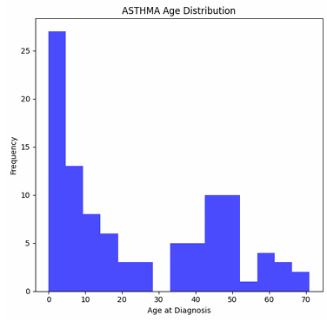
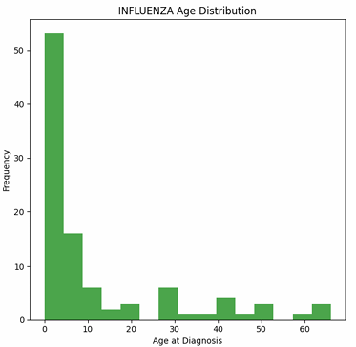
Mean and Median Ages at Diagnosis
Asthma:
- Mean Age: 23.94 years
- Median Age: 16.5 years
- Age range: 0 to 60 years
Influenza:
- Mean Age: 11.98 years
- Median Age: 3.0 years
- Age range: 0 to 60 years

Slide 7
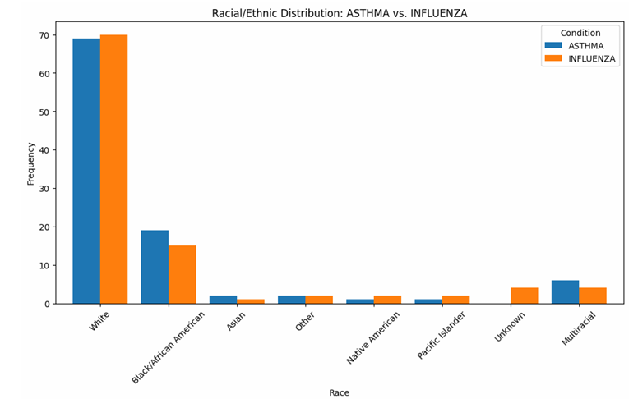
Racial/Ethnic Distribution
Asthma:
- White: 69% (69 out of 100)
- Black: 19% (19 out of 100)
- Others: 12% (12 out of 100)
Influenza:
- White: 70% (70 out of 100)
- Black: 15% (15 out of 100)
- Others: 15% (15 out of 100)

Slide 8
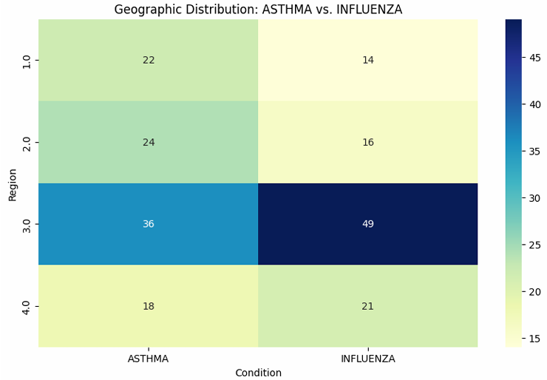
Geographic Distribution
Asthma:
- Northeast: 22% (22 cases)
- Midwest: 24% (24 cases)
- South: 36% (36 cases)
- West: 18% (18 cases)
Influenza:
- Northeast: 14% (14 cases)
- Midwest: 16% (16 cases)
- South: 49% (49 cases)
- West: 21% (21 cases)

Slide 9
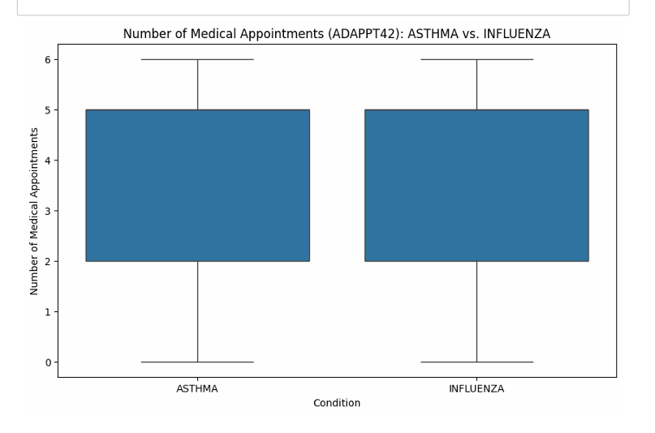
Number of Medical Appointments (ADAPPT42)
Asthma:
- Mean Appointments: 3.74
- Median Appointments: 3
Influenza:
- Mean Appointments: 3.94
- Median Appointments: 4

Slide 10
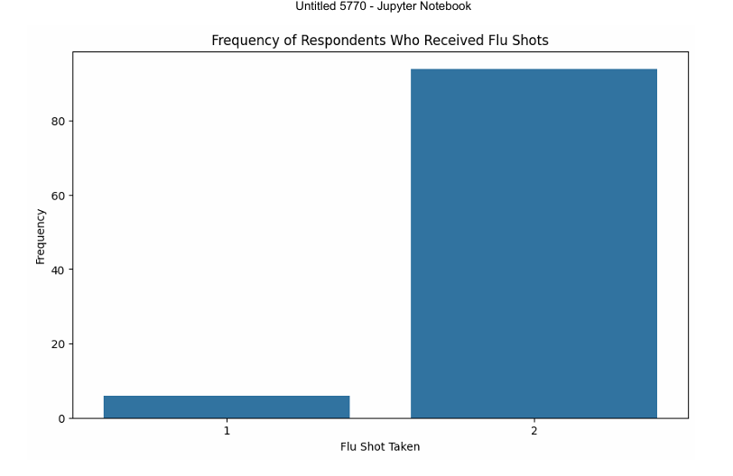
Flu Shot Frequency
Respondents who received flu shots:
- No: 94% (94 out of 100)
- Yes: 6% (6 out of 100)
Age Distribution:
- Most common age group: 10-20 years
- Least common: 70+ years
https://www.cdc.gov/fluvaxview/coverage-by-season/2023-2024.html#:~:text=Flu%20vaccination%20coverage%20among%20adults,since%20the%202020%E2%80%9321%20season.

Slide 11
Chi-Square Test Results
Purpose: Assesses the relationship between categorical variables (e.g., diagnosis type and medical expenditure).
Key Results:
Test statistic: 175.07, p-value: 9.65e-39.
Conclusion: Significant association exists between diagnosis type (Asthma vs. Influenza) and healthcare expenditure.

Slide 12
Mann-Whitney Test Results
Purpose: Evaluates differences in median medical expenditures between Asthma and Influenza groups (non-parametric test).
Key Results:
Test statistic: 6710.0, p-value: 0.00003.
Conclusion: Significant difference in expenditures; Asthma patients generally have higher costs.

Slide 13

CONCLUSION
Impact of Analysis: Draws attention to the significant demographic and financial patterns related to influenza and asthma.
Gender Disparity: Women are more likely than men to get influenza and asthma.
Healthcare Utilization: Patients with asthma typically have greater medical expenses and appointments, which suggests a need for ongoing care.
Actionable Insights: For improved healthcare management, the results can direct the distribution of resources and focused interventions.

Slide 14
REFERENCES
1) Veerapandian, R., Snyder, J. D., & Samarasinghe, A. E. (2018). Influenza in asthmatics: For better or for worse? Frontiers in Immunology, 9. https://doi.org/10.3389/fimmu.2018.01843
2) Li, K. H., Leong, P.-Y., Tseng, C.-F., Wang, Y. H., & Wei, J. C.-C. (2021). Influenza vaccination is associated with lower incidental asthma risk in patients with atopic dermatitis: A nationwide cohort study. Frontiers in Immunology, 12. https://doi.org/10.3389/fimmu.2021.729501
3) Jha, A., Dunning, J., Tunstall, T., Thwaites, R. S., Hoang, L. T., Kon, O. M., Zambon, M. C., Hansel, T. T., & Openshaw, P. J. (2019). Patterns of systemic and local inflammation in patients with asthma hospitalised with influenza. European Respiratory Journal, 54(4), 1900949. https://doi.org/10.1183/13993003.00949-2019
4) Wang, Z., Li, Y., Gao, Y., Fu, Y., Lin, J., Lei, X., Zheng, J., & Jiang, M. (2023). Global, regional, and national burden of asthma and its attributable risk factors from 1990 to 2019: A systematic analysis for the global burden of disease study 2019. Respiratory Research, 24(1). https://doi.org/10.1186/s12931-023-02475-6

Slide 15

THANK YOU

